Slide 1

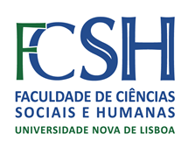
Lisbon Summer School in Linguistics 2018 | 2 – 6 de julho
Brief overview of monolingual
portuguese dictionaries (print only)
From Print to Screen: The Theory and Practice of Digitizing Dictionaries | Toma Tasovac
Ana Salgado | Isabel Maria | Luís Salema

Slide 2

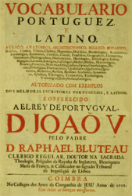

1712
-
1728
Vocabulario Portuguez e Latino
Raphael Bluteau
43 664 entries
It marks the transition between the Latin-Portuguese dictionary and the first monolingual dictionary

Slide 3
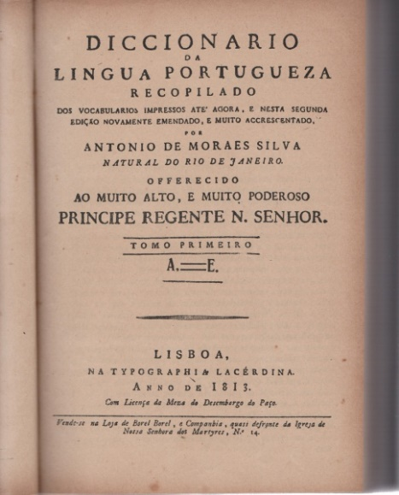
Dicionário da Língua Portuguesa composto pelo padre D. Rafael Bluteau, reformado, e accrescentado por
António de Morais de Silva
1789
First Portuguese monolingual dictionary
Over more than two centuries, it was the most important reference for lexical use in Portugal and Brazil
Bluteau’s vocabulary summary + 22 000 news entries
Simplification and regularization of spelling
Different editions during the 19th century (a work in 12 volumes and a compact version)

Slide 4
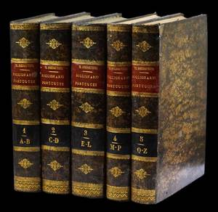
1871
-
1874
Grande Diccionario Portuguez ou Thesouro da Lingua Portugueza
(5 vols.)
Frei Domingos Vieira
Incidence on the linguistic component, with nomenclature multiplied by inflected forms
Quotes from «good authors»
Little etymological rigor and poor semantic description

Slide 5
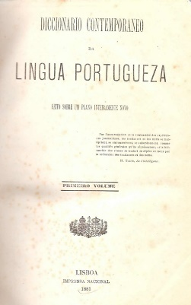
1881
Dicionário Contemporâneo da Língua Portuguesa
Caldas Aulete, António Lopes dos Santos Valente
Good introductory text (lexicographic reflection)
Nomenclature update (neologisms of use and necessary)
Collection of colloquial and popular vocabulary, regionalisms, terminology (scientific and technical)

Slide 6
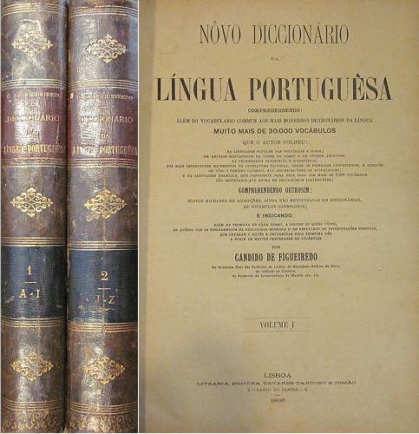
Novo Diccionario da lingua portuguesa
Cândido Figueiredo
1899
About 110 000 entries
237 classifiers or descriptors (abbreviations, symbols, etc.)
Special collection of colloquial and popular vocabulary, regionalisms, terminology (scientific and technical)
Simplification of articles and without citations
Small dictionary in 1924
Last edition: 1996

Slide 7
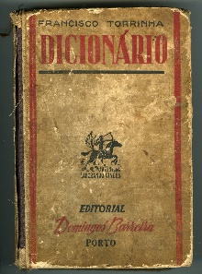
20th Century
Dictionary democratization
Moderno Dicionário da Língua Portuguesa. Para os estudantes e para o povo. Ortográfico, prosódico e morfológico (1931)
Francisco Torrinha
Dicionário Elementar da Língua Portuguesa (1934)
Augusto Moreno
Grande Dicionário da Língua Portuguesa (1981)
José Pedro Machado
Porto Editora dictionaries
– Dicionários Editora da Língua Portuguesa («the orange dictionary», 1.ª ed. 1952 – …)
– Grande Dicionário da Língua Portuguesa, 2004, 2009
Texto Editores dictionaries
– Dicionários Universal
First dictionaries with the spelling reform in 2008
Adaptations of the Houaiss dictionary (2002/3-2016)

Slide 8
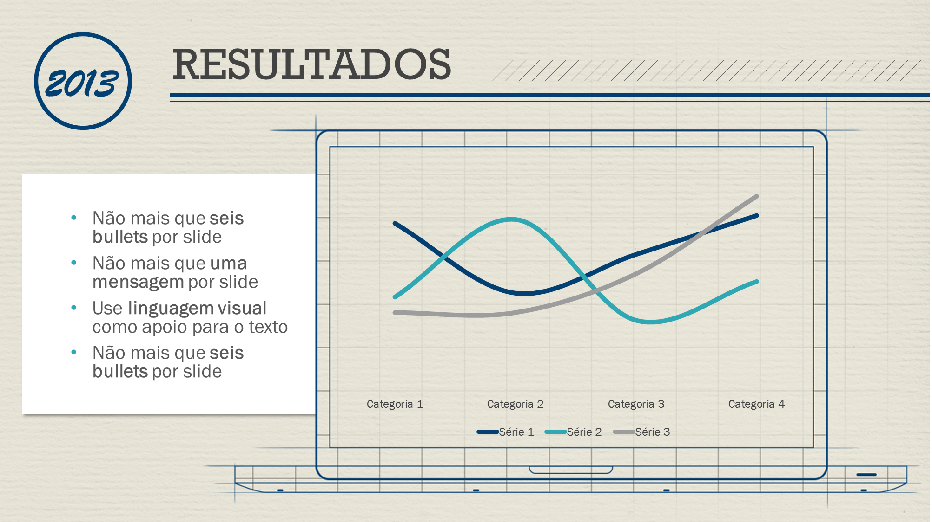

Academic attempts
Dictionaries of the Lisbon Academy of Sciences
Pedro José da Fonseca, Bartolomeu I. Jorge, Agostinho J. da Costa de Macedo; Jacinto Prado Coelho; Malaca Casteleiro
1793
1976
2001
2015
1st academic dictionary: Diccionario da lingoa portugueza publicado pela Academia Real das Sciencias de Lisboa
Letter A (azurrar)
Dicionário da Língua Portuguesa
Letter A (azuverte)
Dicionário da Língua Portuguesa Contemprânea
First full academic dictionary
From A to Z
70 000 entries
based in a corpus
New edition in progress
100 000 entries
Good structuring of articles (grammatical classification, gender, number, irregularities, verbal regencies, use, variety, orthographic variants, definition, citations

Slide 9
Referências:
Biderman, M.T.C. Dicionários do português: da tradição à contemporaneidade. Alfa, São Paulo, n. 47, v. 1, p. 53-69, 2003.
Telmo e J.P. Silvestre (orgs.) Dicionarística Portuguesa, Inventariação e Estudo do Património Lexicográfico, Aveiro, Universidade de Aveiro, 2007.
Thank you.

